Slide 1
Advanced Programming
Unit 4: functions & recursion

Slide 2
What is a function?
In programming, a ‘function’ is a self contained module of code that accomplishes a specific task
Functions provide a way to make code modular
In OO programming, these belong to classes and are called methods
In mathematics, the word ‘function’ has a more specific meaning
A function is a relation, or mapping between a set of inputs and a set of permissible outputs with the property that each input is related to exactly one output
For example:
f(x) = x²
Maps any number (x) to the square of that number, e.g. f(3) = 9, f(4) = 16
For given input x you always get the same result
You don’t change x in process
Functional programming is based on the mathematical definition

Slide 3
Composition
Combination of individual units to perform a more complex task
In OO programming we compose objects to model a complex scenario, so classes are the building blocks of OO programming
In functional programming, we can compose functions rather like the way mathematical functions can be composed
Functions are the building blocks of functional programming
For example, mathematical functions f, g and h can be defined as
f(x) = x²
g(x) = x + 2
h(x) = f(g(x)) - h is a composition of f and g
So h(3) = f(g(3)) = f(3+2) = f(5) = 25 - what about (g(f(x))?
5
3 g(3) f(5) 25
output (5) from first function is input to second function

Slide 4
First class functions
Core value of functional programming is that functions should be first-class.
Can be declared and invoked and can be used in every segment of the language as just another data type
Function declaration is of the form:
def functionName ([list of parameters]) : [return type] = { function body return [expr] }
A function that doesn’t return anything can return a Unit (equivalent to void in Java)
Return statement is optional, if not present will return last expression evaluated in body

Slide 5
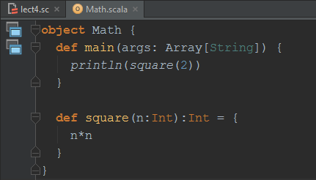
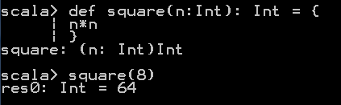
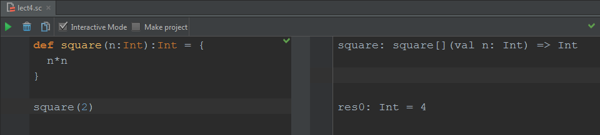
Declaring a function
Can declare standalone in REPL or Scala Worksheet, or in a class/object as a method

Slide 6
Function examples
scala> def higher(x:Int, y:Int):Int = { if(x >= y) x else y } higher: (x: Int, y: Int) => Int scala> higher(2,4) res0: Int = 4
def alert(message:String):Unit = { println(message) }
alert("Hi")
this method higher takes two Int parameters and returns an Int. Note that the value of the expression evaluated in whichever branch of the if statement (i.e. the value of x or y) is returned
in REPL, function definition is evaluated and displayed - this shows that the value of the function definition is a function of two Ints that returns an Int (for brevity, won’t show REPL response for all function examples, but you can try them for yourself to see these)
this method alert simply prints the value of the String parameter, it does not return any value, so the return type is Unit

Slide 7
Function examples (cont.)
These functions are declared as function literals (or anonymous functions) using lambda expressions
Each function is assigned to a variable - variable refers to function, not to a value, and you can call the function using the variable name
var s = (n:Int) => n*n s(3)
var h = (x:Int,y:Int) => { if(x > y) x else y }
h(3,4)
simple function where body is a single expression
function with multiline body

Slide 8
Function examples (cont.)
This example shows a function with a variable number of parameters, indicated by the * in the function declaration
def sum(x:Int*):Int = { var result = 0 for(i <- x){ result = result + i } result } sum(1,2,3) sum(3,4,5,6,7)
Note this example does work, and does illustrate variable parameters – but is it written in a functional programming style?

Slide 9
Nested functions
You can declare a function anywhere, including nested inside another function
This example is a function min that declares a nested, or inner, function lower to break down the job of calculating the minimum of three numbers into calculating the lower of two numbers twice
def min(x: Int, y: Int, z: Int) = { def lower(i: Int, j: Int) = { if (i < j) i else j } lower(x,lower(y,z)) } min(4,2,9)
Nested functions are often used to help optimise recursion as you will see shortly, although this example is not recursive
How would you have written the last line? You might have done it like this:
var result = lower(x,y) result = lower(result, z)
That would work, but is not as “functional” as it could be as it explicitly defines steps and stores an intermediate result. The version here simply evaluates an expression with function calls

Slide 10
Recursion
A technique for solving problems which have a naturally repetitive streak to them
a problem where you are repeatedly performing actions on 'smaller' and 'smaller' 'objects'
analogies:
Russian doll
onion
a function/method calls a ‘smaller’ version of itself which calls a 'smaller' version still and so on
there must be some stopping point or get out clause
i.e. there needs to be a way of stopping an infinite set of calls by providing an alternative which doesn't call another version of itself
Recursion provides a more functional alternative to iteration
No mutable state, e.g. no count or “running total” variables
Some “pure” functional languages, e.g. Haskell, don’t provide while/for loops, need recursion to iterate

Slide 11
Recursion Example
consider the expression 3⁴
i.e. 3 * 3 * 3 * 3
however, we can also write this as:
3 * (3 * 3 * 3) i.e. 3 * 3³
or as:
3 * (3 * (3 * 3)) i.e. 3 * (3 * 3²)
or as:
3 * (3 * (3 * (3))) i.e. 3 * (3 * (3 * 3¹))
public static int power(int x, int y) {
if (y == 1)
return x;
else
return x * power(x, y-1);
}

Slide 12
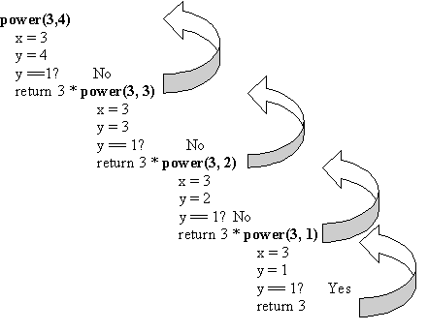
Trace
81
27
9
3

Slide 13
Revisit motivating example – recursion in Java
Example - what happens if we call factorial(3)?
Recursive function defines:
recursive call to same function
stopping condition/base value – don’t want to recurse forever!
(note that this version is written with an if, equivalent to version earlier with match)
public int factorial(int n) { if(n==0 || n==1) return 1; return factorial(n-1) * n; }
n=3
calls factorial(2)
public int factorial(int n) { if(n==0 || n==1) return 1; return factorial(n-1) * n; }
n=2
calls factorial(1)
returns 1*2 = 2
public int factorial(int n) { if(n==0 || n==1) return 1; return factorial(n-1) * n; }
n=1
returns result 2*3 = 6 to calling code
returns 1

Slide 14
Recursion Issues
There is a downside – the Java example here will crash if n becomes large enough (about 15000 when I tried it), and not because the numbers get large in the case of factorials
Every function call creates a stack frame in stack memory to hold parameters/local variables
Stack frame needs to be kept in memory until function completes
In example, by the time the call to factorial(1) is made there will be 3 stack frames in memory
factorial(15000) would try to create 15000 stack frames, each of which takes up memory – can lead to stack overflow
Can avoid this with a technique called tail recursion which is typically supported in functional languages including Scala – involves slight change to design of code to allow compiler to perform an optimisation

Slide 15
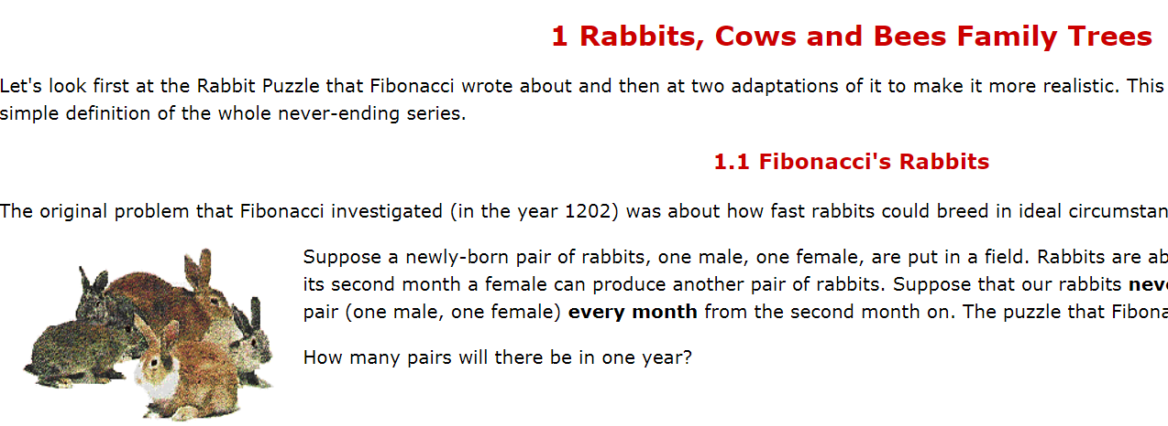
Fibonacci numbers
set of numbers with a regular pattern which appear in a variety of guises in nature (and other places)
http://www.maths.surrey.ac.uk/hosted-sites/R.Knott/Fibonacci/fib.html

Slide 16
Fibonacci numbers (cont.)
1 | 2 | 3 | 5 | 8 | 13 | 21 | 34 | 55 | 89 | 144 | 233
The key to this series is that the next number is the sum of the last two numbers i.e.
Fibonacci(n) = Fibonacci(n-1) + Fibonacci(n - 2)
This is an ideal situation for recursion
public static int fibonacci(int n) {
if (n <= 2)
return 1;
else
return fibonacci(n-1) + fibonacci(n-2);
}

Slide 17
Recursion & Optimisation
Note that recursion can cause stack overflow as each recursive call creates a new stack frame
Most functional languages have the capability to optimise recursive calls to avoid this problem
They do so because recursion is an important technique for programming in a functional style
To understand how to make use of this, we need to distinguish between:
Head recursion
function makes its recursive call and then performs some more calculations, maybe using the result of the recursive call
Tail recursion
all calculations happen first and the recursive call is the last thing that happens

Slide 18
Factorial example – which kind?
So which of these is this factorial example (similar to the one you saw previously)?
def factorial(n: Int): Int = { if (n<=1) n else factorial(n-1) * n }
Although the recursive call to factorial is in the last line of the function, the call is not the last act in evaluating the expression in that line
To evaluate this:
Function is called and value of factorial(n-1) returned
That value is multiplied by n
So multiplication calculation is done after the recursive call – head recursion

Slide 19
Recursion and the stack frame
What happens on the stack if we call factorial(3)?
Non-optimised call:
Each box represents a stack frame
Stack memory allocated to store function (or method) call with local variables/parameters
Removed from stack only when function execution completes
Each recursive call creates a new frame – all these stack frames are separate calls to the same function
factorial(1)
return
call
factorial(2)
factorial(2)
factorial(2)
factorial(3)
factorial(3)
factorial(3)
factorial(3)
factorial(3)

Slide 20
Optimising recursion
Optimisation works by re-using the stack frame for the next function call
Only possible if all other work (e.g. calculations) in the function is completed before recursive call, so local variables/parameters in that frame are no longer needed – needs tail recursion
Optimised call:
Same frame re-used for each call
Stack use doesn’t “grow” so will not overflow
Scala compiler does this optimisation “under the hood” when it identifies a tail recursive call
Note that recursion is not exclusively a feature of functional languages, but is more likely to be used by “functional-thinking” programmers so compilers of functional languages are more likely to implement this optimisation
call
return
factorial(3)
factorial(2)
factorial(1)
factorial(2)
factorial(3)

Slide 21
Making functions tail-recursive
To take advantage of optimisation need to modify factorial function to be tail recursive
A common technique for situations like this is to use a nested function as a helper
factorial function has same signature as before
def factorial (i: Int): Int = {
def fact(i: Int, accumulator: Int): Int = { if (i <= 1) accumulator else fact(i - 1, i * accumulator) }
fact(i, 1) }
inside this factorial method we declare and call the nested function fact
fact function is tail recursive – no calculation done after function call returns – multiplication is done before function call and result passed as parameter
Can you follow how the fact method works? Why is the second parameter value in the nested call 1? Hint: it essentially does the calculation in the reverse order to the original version of factorial

Slide 22
Why use a nested function for tail recursion?
If you look at the nested method fact in the example, it actually does all the work of calculating the factorial
You could have fact as a standalone function, and call it, e.g. fact(4,1), which would calculate the factorial of 4 correctly
There are two problems with this:
The second parameter is only there because of the way the function works, it has no meaning in the context of the purpose of the function – you just want to calculate factorial of 4
There would be nothing to prevent a call such as fact(4,2). What would this mean? Well, it wouldn’t calculate the factorial of 4, anyway.
Nesting inside the factorial method avoids these problems:
Provides method with sensible signature, e.g. call factorial(4) to get the factorial of 4 – simples!
Prevents fact being called directly with possibly meaningless results – scope of method is inside the method where it was declared

Slide 23
Partial function application
In imperative programming we might think of calling a function and supplying parameters to the function to give it the information it requires
Generally need to supply all the parameters, although some languages support default values
Calling a function always returns a result of the function’s return type
Lambda calculus provides functional programming with an alternative way of thinking about this – we apply a function to the parameters
Don’t necessarily have to apply the function to all the parameters
For example, here is a simple function that adds three numbers, each of which is a parameter of the function, and returns the result as an Int
def sum(a:Int, b:Int, c:Int): Int = { a+b+c}
Can apply this to three parameters and assign the result to a variable f, which then refers to an Int
scala> val f = sum(1,2,3) f: Int = 6

Slide 24
Partial function application (cont.)
Can apply this function to two parameters only and assign the result to a variable f – this is partial application of the function
scala> val f = sum(1, 2, _: Int) f: Int => Int = <function1>
Note the _ indicates that the function is not to be applied to the parameter at that position in the list
The result of partial application is not an Int – it is a function!
So, the variable f refers to a function, not a value
Can call the function later – now fully applied so get a value with the return type of the original function
scala> val g = f(3) g: Int = 6
the underscore ( _ ) symbol is used for several different purposes in Scala. You will come across some others in later examples

Slide 25
Partial function application - another example
This function might be useful in a program that generates HTML - will wrap an element with a specified prefix and suffix :
def wrap(prefix: String, html: String, suffix: String) = { prefix + html + suffix }
This is a very general function which might be used in a wide range of situations. However, it might be common to need a specific wrapping, e.g. wrap an element in <div></div>.Can create a new function to do this by partially applying the general function:
scala> val wrapWithDiv = wrap("<div>", _: String, "</div>") wrapWithDiv: String => String = <function1>
Can call this to wrap any HTML, don’t need to call general function and specify <div> and </div> each time
scala> wrapWithDiv("<p>Hello, world</p>") res0: String = <div><p>Hello, world</p></div> scala> wrapWithDiv("<img src=\"/images/foo.png\" />") res1: String = <div><img src="/images/foo.png" /></div>
as in previous example, variable wrapWithDiv refers to a function – this takes one parameter instead of the three params of the original wrap function

Slide 26
Higher-order functions
You’ve seen that functions in Scala can be assigned to variables, just like values can (either explicitly or as a result of partial application of a function)
Functions can be used like values in other ways, for example:
passed as parameters to functions
returned from functions
A function that takes other functions as parameters, or whose result is a function, is known as a higher-order function
These can be extremely useful and are now supported and widely used in many languages, including mainstream ones (for example, they are used to implement callback functions that are very important in JavaScript)

Slide 27
Functions as function parameters
Here are three simple function definitions (two named, the other anonymous and assigned to a variable), each takes a single Int parameter and returns an Int ( function type is Int => Int)
def square(n:Int):Int = {n*n}
def cube(n:Int):Int = {n*n*n}
val double = (x:Int) => x * 2
The following higher-order function takes a function of type Int => Int as a parameter, and applies that to the other parameter, which is an Int
def calculate(f: Int => Int, x: Int) = f(x)
Can call calculate with any of these functions as a parameter, and it will apply that function to the other parameter
calculate(square, 5) calculate(cube, 5) calculate(double, 10)
note that calculate doesn’t need to know anything about the function that it applies other than its parameter and return types – it will quite happily apply any function of type Int => Int

Slide 28
Functions as return types
This function adds a prefix to a String and returns the result as a String
def saySomething(prefix: String) = { prefix + " " + s }
Return type is not explicitly stated, compiler works it out from type of expression returned
Function definition (after = ) is a block that is evaluated when the function is called
This higher-order version returns a function that will add a prefix to a String
def saySomething(prefix: String) = (s: String) => { prefix + " " + s }
Function definition (after = ) is a lambda expression
Code block in {} is not evaluated immediately when this function saySomething is called
Again, return type is not explicitly stated, compiler works it out from lambda expression

Slide 29
Functions as return types (cont.)
Let’s call the higher-order saySomething function:
scala> val sayHello = saySomething("Hello") sayHello: String => String = <function1>
Nothing has been “said” yet, but calling saySomething with the parameter “Hello” has given is a function, (referenced by the variable sayHello) that will add the specific prefix “Hello “ to its parameter
Let’s call that: scala> sayHello("World!") res0: String = Hello World!
Now the code block has been evaluated and a String returned with the result
So saySomething is a “function factory” that can be called to create a function that will add a specific prefix to a String when that function is called. What would saySomething(“Hey”) create?
result is a function
result is a value

Slide 30
Practical application - filtering
Stated that HO functions are extremely useful –here’s a practical example that shows how we can use a HO function to filter a collection of integers
Want to start with a collection and get back another collection that only contains the ones we are interested in
In this case this will be the even numbers only
Imperative solution would involve the following steps:
Create empty collection for result
Iterate through initial collection
For each item in initial collection, check whether it is even
If so, add to result collection
When iteration is complete, return result collection

Slide 31
Practical application – filtering (cont.)
Functional solution notes that there are actually just two transforms here:
Transform a value to a boolean that is true if the value is even, false otherwise
Transform the collection to another collection by applying the first transform and including only the values which return true
So, solve problem by defining functions to do each of these transforms and composing them
Remember, when thinking functionally you don’t think about performing the required action not by executing a series of steps
Instead, you think about expressing the required action as a description of the result you want

Slide 32
Practical application – filtering (cont.)
First transform becomes a predicate – a function that returns a boolean
def mypredicate(x: Int): Boolean = { if(x%2 == 0) true else false }
Second transform becomes a filter – a function that selects only the elements of a collection for which the predicate is true
Predicate function is a parameter for the filter function
def filter(l:List[Int], f:Int => Boolean): List[Int] = { for(x <- l if f(x)) yield x }
Note that the filter function doesn’t know anything about this specific predicate function, could apply any predicate
this parameter is a function of predicate type
predicate function is applied in the filter function

Slide 33
Some common types of function
The general term function refers to any function that can take arguments (parameters) and return any type
The term predicate is commonly used to refer to a specific type of function that expresses some kind of condition and returns a boolean
In English, the verb predicate means to require something as a condition of something else
The following terms are sometimes used to describe specific types of function:
Function – can return any type
Consumer or Action – function that doesn’t return anything
Supplier – function that takes no parameters and returns a value
Predicate – function that returns boolean
These terms are used formally as function types in some languages (not Scala, though), e.g C# has Func, Action and Predicate types, Java 8 has Function, Consumer, Supplier, Predicate interfaces

Slide 34
Composition with HO functions
The following call composes our filter and predicate functions:
scala> filter(List(1,2,3,4,5,6), mypredicate) res0: List[Int] = List(2, 4, 6)
Composition gives great flexibility - let’s say we want to solve a different filtering problem, to get only the values in the list that are > 3
Can use the same filter function, but compose it with a different predicate
This example defines the predicate using a lambda expression rather than declaring a named function:
scala> filter(List(1,2,3,4,5,6), (x:Int) => x > 3) res1: List[Int] = List(4, 5, 6)
Note that Scala also allows a very compact syntax for lambdas with one parameter – another use for the underscore symbol:
filter(List(1,2,3,4,5,6), _ > 3)

Slide 35
Scala collection functional combinators
The filtering example you have seen works, but you don’t actually need to write your own filter function for a Scala collections
Collections have many HO functions “built-in” that can be composed with your own functions to provide ways to transform those collections – functional combinators
You saw the examples using the exists and filter functions
The predicate defined here (or any other predicate defined as a named function, a function variable or a lambda) can be used to filter a List like this:
scala> List(1,2,3,4,5,6).filter(mypredicate) res2: List[Int] = List(2, 4, 6)

